Slide 1
For a leading pharmaceutical client, we predicted the impact of new product launch on client’s mature product in the market
Case study: Impact of launch of new product on existing mature product (1/2)
Situation
Methodology
The client is a leading healthcare company with sales in more than 130 countries worldwide
Client launched a drug in 2000 and has maintained a steady market share of ~28%
In 2009 competitor launched a new product which has found acceptance in the market
Identify the Source of Business
Determine the Switch pattern
Measure Persistence and compliance
Create Adoption Segments
Complication
Model the rate of adoption for each segment
Quantify loss due to switching
Model prescription trend for physician & other factors (payer, calls etc) within a segment
Predict physicians who might be At Risk
In the recent past the client product has been steadily losing market share
Product has reached maturity, with the patent to expire in 2012 and there are no drugs in the pipeline for the defined market
Complication
Outcome
What is the impact of the new product launch on client product due to switching?
Who are the physicians that are At Risk of moving from client product to competitor product
Decision support on
Quantifying threat from new product and areas of concern
Identifying doctors at risk, before they switch to competitor
Business impact
Curbed market share loss
Increased ROI of sales force effort

Slide 2
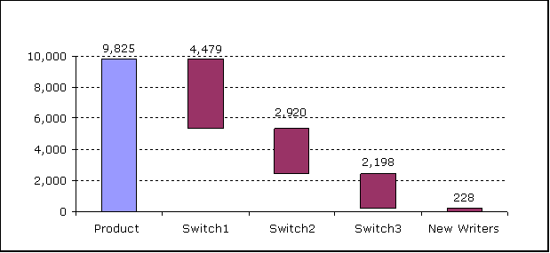
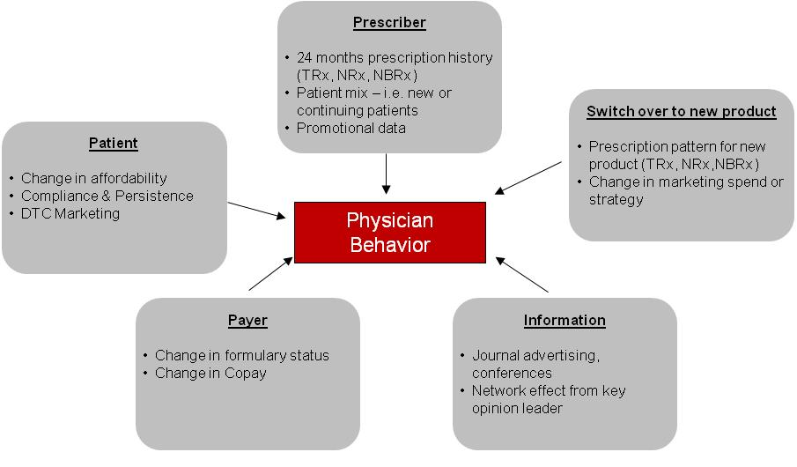
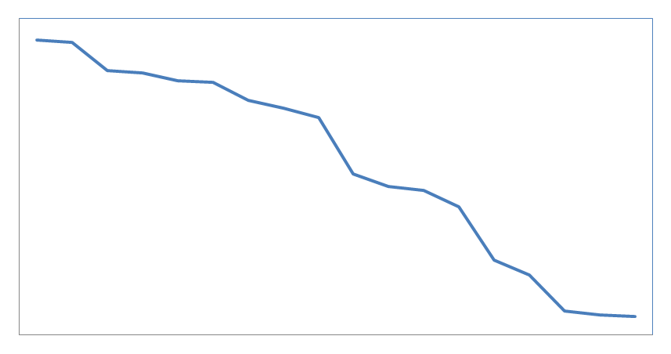
We developed adoption based models to quantify overall potential loss and identify physicians “At Risk” of switching
Case study: Impact of launch of new product on existing mature product (2/2)
1
Adoption curve based models to quantify overall potential loss to existing drug on the account of new drug launch
Adoption curves by physicians segments
Switch over analysis to new drug
Persistency analysis
MD Count
% Persistent
Potential loss = Fn (Rate of adoption, Persistency, compliance)*Fn (Switch over) Rate of adoption = Fn ( number of early adopters, number of late adopters, initial growth rate of each wave, late stage growth rate)
2
Physician level modeling to identify physicians “At Risk” of switching over to new drug
flag the physicians at this point to allow pro-active action
Composite “At Risk” Index
TRx Share
Past
Present Day
Future
Back

